Slide 1
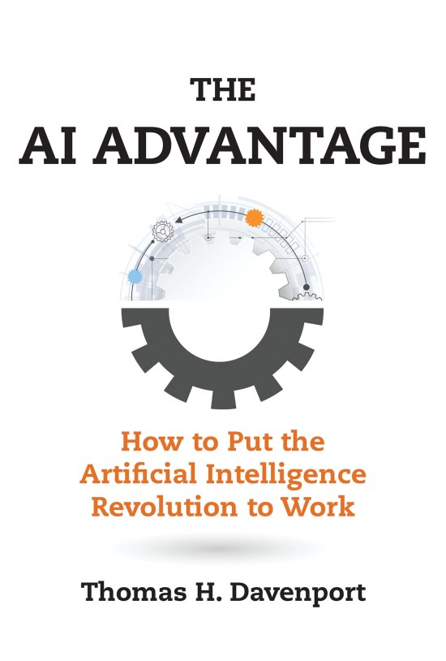
AI in the Post-Pandemic Enterprise
Thomas H. Davenport
Babson College/MIT/Deloitte
MIT CIO Symposium Digital Learning Series
June 10, 2020

Slide 2
The State of AI in Large Companies in Mid-2020
About 40% are “AI-aware” globally and actively employing multiple technologies (ML and NLP, automation)
A few are “AI powered”
Challenges getting systems into production
Diverse objectives beyond automation, but 63% will automate “as many jobs as possible”
Collections of ”low hanging fruit” seem to prevail over ”moon shots”
The more experienced, the more bullish
Pandemic economy wreaking data havoc on models
Increased focus on automation technologies

Slide 3
The Road to AI-Powered Enterprises
One major “robo-advisor” application
About 150 AI projects, many in marketing and sales—not drug development
About 1000 projects, mostly in machine learning for credit, risk, marketing
Several thousand projects in search, ads, autonomous vehicles, etc., etc.
3 | 2020 © Thomas H. Davenport All Rights Reserved

Slide 4
How Ambitious a Project?
Treating cancer
“Robo-advisor”
Go stores
Drone delivery
“Care concierge”
Predicted no-pays
IT operations
India chatbot
ATM cash
Sales attrition
Fraud detection
Product recs
Merchandising

Slide 5
Evidence of a “Return on AI” Problem
Seven out of ten companies in an MIT SMR/BCG survey report minimal or no impact from AI thus far
Only 15% of respondents to a NewVantage Partners survey report any production deployment of AI
In a McKinsey global survey, only 21% of respondents have embedded AI into multiple business units or functions
The Gartner 2020 CIO Agenda survey report comments: “the reality is that most organizations struggle to scale the AI pilots into enterprise wide production, which limits the ability to realize AI’s potential business value.”
Deloitte surveys report that the greatest challenges to AI are implementation issues, integrating AI into existing systems and processes, and data
Mission Control in Houston, Apollo 13

Slide 6
One Big Reason—Too Many AI Pilots!

Slide 7
Four Paths to Return on AI
R
Reengineer business processes to take advantage of AI and yield productivity
Organization and culture that are data-driven and a fit with AI initiatives
Algorithms and data that are unbiased, transparent, and well-managed over time
Investment that is both substantial and well-managed, with clear metrics
O
A
I
7 | 2020 © Thomas H. Davenport All Rights Reserved

Slide 8
Post-Pandemic Management of AI
Think big, start small
Best companies won’t ease up; sitting on the sidelines may be costly
Re-prioritize existing projects
Seek new sources of data, including external
Redesign, reskill, reinvest in work and workers
Augment remaining workers with automation
Plan to scale up systems from the beginning
Develop governance and methodology for ongoing management and ROI
Put an ethical framework in place
8 | 2020 © Thomas H. Davenport. All Rights Reserved

